Slide 1



Slide 2


SMART BLIND STICK
GUIDED BY:
MRS P.SAKTHI

Slide 3

TEAM MEMBERS
S.P..VASHANTH (927621BEC235)
S.YUVAN SANKAR RAJA(927621BEC249)
R.K.SHANJAY (927621BEC195)
S.YUVARAJ (927621BEC251)

Slide 4
.
OBJECTIVE
*BlindPeople who suffer from a severe reduction in vision that cannot be corrected with conventional means, such as refractive correction or medication and reduces a person's ability to function at certain or all tasks.

Slide 5
.
ABSTRACT
*Smart Blind Stick is a system device that incorporates several features, namely- obstacle detection, navigation, panic button, and moisture detector.
*The main objective of the device is to help blind people to walk with complete relief and self-dependency

Slide 6

.
introduction
*IntroductionPresently, blind people use a white stick as a tool for direction, when they move or walk.
*Here, we develop a tool which can serve as a blind stick being more efficient and helpful than the conventional one.

Slide 7
*Atmega8 *MicrocontrollerIR sensor *Dig sensor Power supply section (+5V)- onboard *7805 and 7812 regulators *In4007(diode) *Tracking circuit mainly consists of
.
COMPONENTS

Slide 8
.
*ISP (in-system programmer)
*CapacitorDe jack
*male/female
*Transformer
*Capacitor
*Transformer
*Diode
*IR sensor
*Dig sensor
*Crystal
*Resistor

Slide 9
.
SOFTWARE DEVELOPMENT
*Software developmentFirmware for the modules has been developed with the help of WinAvr compiler and AVRstudio.
*The controller is programmed with help of AVRDUDE.
*The software is written in c language and compiled using the open source compiler Avr gee. For project management AVR studio was used

Slide 10
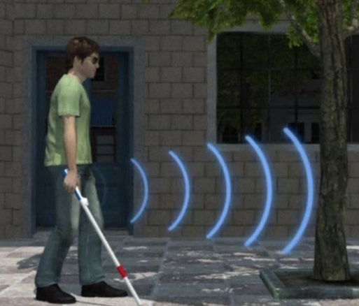
*Help blind people to easily walk to destination. *Help blind people for obstacle detection. *Alert blind people about dig.
APPLICATION

Slide 11
,
ADVANTAGE
*Auto detection.
*Having feature to left & right turn alarm signal.
*Obstacle detection with indication support.
*Dig information with indication alarm.
*Simple to use & low cost

Slide 12

2

